Slide 1
SPEC TRAFFIC AI
EXPLAINABLE TRAFFIC VIOLATION DETECTION FOR INDIAN ROADS
Mentor: PROF - MEHER GAYATRI
Rishik Reddy P 23WU0102149
Rohan Reddy - 23WU0102169
Hari Ramaneti - 23WU0102135

Slide 2
RECAP
Evaluation 1 proposed the architecture. This is the working system.
Detector trained on DriveIndia: 21 India-specific classes
Full pipeline built: ingest, detect, track, judge, capture, score
Runs on real traffic footage today, not a simulation
Code, weights and evaluation charts published publicly

Slide 3
LITERATURE REVIEW
WORK | CONTRIBUTION | REPORTED | LIMITATION FOR ENFORCEMENT
DriveIndia 2025 [1] | Large Indian road dataset; auto-rickshaw and other classes absent from COCO | 78.7% mAP@50 | Dashcam viewpoint. Detection only - no violation logic, no evidence
Ravish et al. 2021 [2] | End-to-end pipeline: helmet, triple riding, ANPR, automated ticketing | Working prototype | No held-out evaluation. Evidence quality is never modelled
Ren 2024 [3] | Computer vision plus human-computer interaction over eight violation types | >96.9% accuracy; 99.7% on red-light | Laboratory accuracy only - no held-out split and no field deployment
BMD-45 2026 [4] | 480k boxes from 3.6k operational Indian CCTV cameras | 83.8% in-domain vs 33.6% cross-domain | Confirms viewpoint transfer collapses. Still detection, not enforceability
Wilson et al. Cochrane 2010 [6] | Systematic review of 35 automated speed-enforcement studies | Crashes down 8-49% | Enforcement works - but only once a challan is issued AND upheld
Automated enforcement works: crashes down 8-49% across 35 studies [6]; spot cameras cut fatal crashes 51%, section control 56% of KSI crashes [7]
India needs it: overspeeding in 68.4% of accidents; 54,568 killed without a helmet in 2023 [8]

Slide 4
WHERE IT BREAKS DOWN
Bengaluru ITMS: helmet detection 75-80% raw, 99.9% only after MANUAL revalidation [10]
Kerala: 66.41 lakh violations, Rs 428 cr issued, only Rs 76.7 cr collected [9]
Ren reports 98% lab accuracy with no held-out split and no field deployment [3]
Cross-domain collapse: 83.8% in-domain falls to 33.6% on Indian CCTV [4]
UK field study: ANPR misreads 28.5% of number plates [5]
Legal wall: without a Section 65B certificate, footage is inadmissible [13]

Slide 5
RESEARCH GAP
Train a detector on Indian road data that recognises auto-rickshaws and two-wheelers, classes absent from general-purpose models such as COCO.
1
Human review exists only as retrospective manual labour, as Bengaluru shows, never as a scored, prioritised signal inside the pipeline.
2
Admissibility never enters the CV pipeline. No published system carries an evidence-quality metric or chain-of-custody concept.
3

Slide 6
OBJECTIVES
Train a detector on Indian road data that recognises auto-rickshaws and two-wheelers, classes absent from general-purpose models such as COCO.
1
Build a modular rule engine in which each violation is an independent, calibrated geometric module operating over one shared perception pass.
2
Score whether each detection could survive a legal challenge, and route it for officer approval before any challan is issued.
3

Slide 7
WHAT WE BUILT
Ingestion: file, RTSP or live camera behind one interface
Detection: YOLO11 fine-tuned on DriveIndia, 21 Indian classes
Tracking: ByteTrack, a Kalman filter, not a learned model
Rule engine: self-registering modules, temporal consistency inherited
Evidence: rolling buffer captures approach, violation and departure
Calibration: draw lanes, headings, arms and stop lines on a real frame
Signal timing: per-arm congestion in PCU, Webster green split, advisory

Slide 8

HOW IT WORKS
1
2
3
4
Ingest - file, RTSP or live camera behind one interface
Detect and Track - 21 Indian classes, persistent identities
Judge - calibrated geometric rules, temporal consistency
Capture and Score - evidence clip plus defensibility score

Slide 9
RESULTS
0.703 mAP@50 across all 21 classes, measured on the official held-out test split. DriveIndia publishes a baseline of 78.7 percent on the full dataset.
1
0.800 mAP@50 across the 18 classes with adequate training support. Three classes had fewer than 100 instances and could not be learned.
2
0.868 mAP@50 across the seven enforcement-relevant classes. Auto-rickshaw, absent from COCO entirely, reaches 0.888.
3

Slide 10
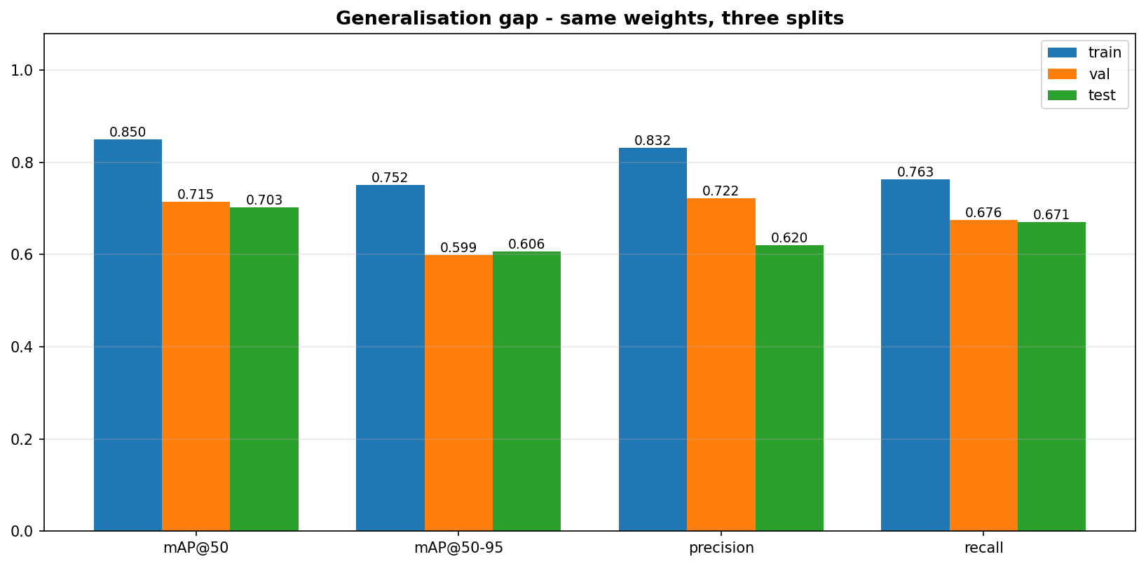
GENERALISATION GAP
Same weights, evaluated on all three splits
Validation and test agree closely: the split is representative
Most published work reports the blue bar. We report the green.

Slide 11
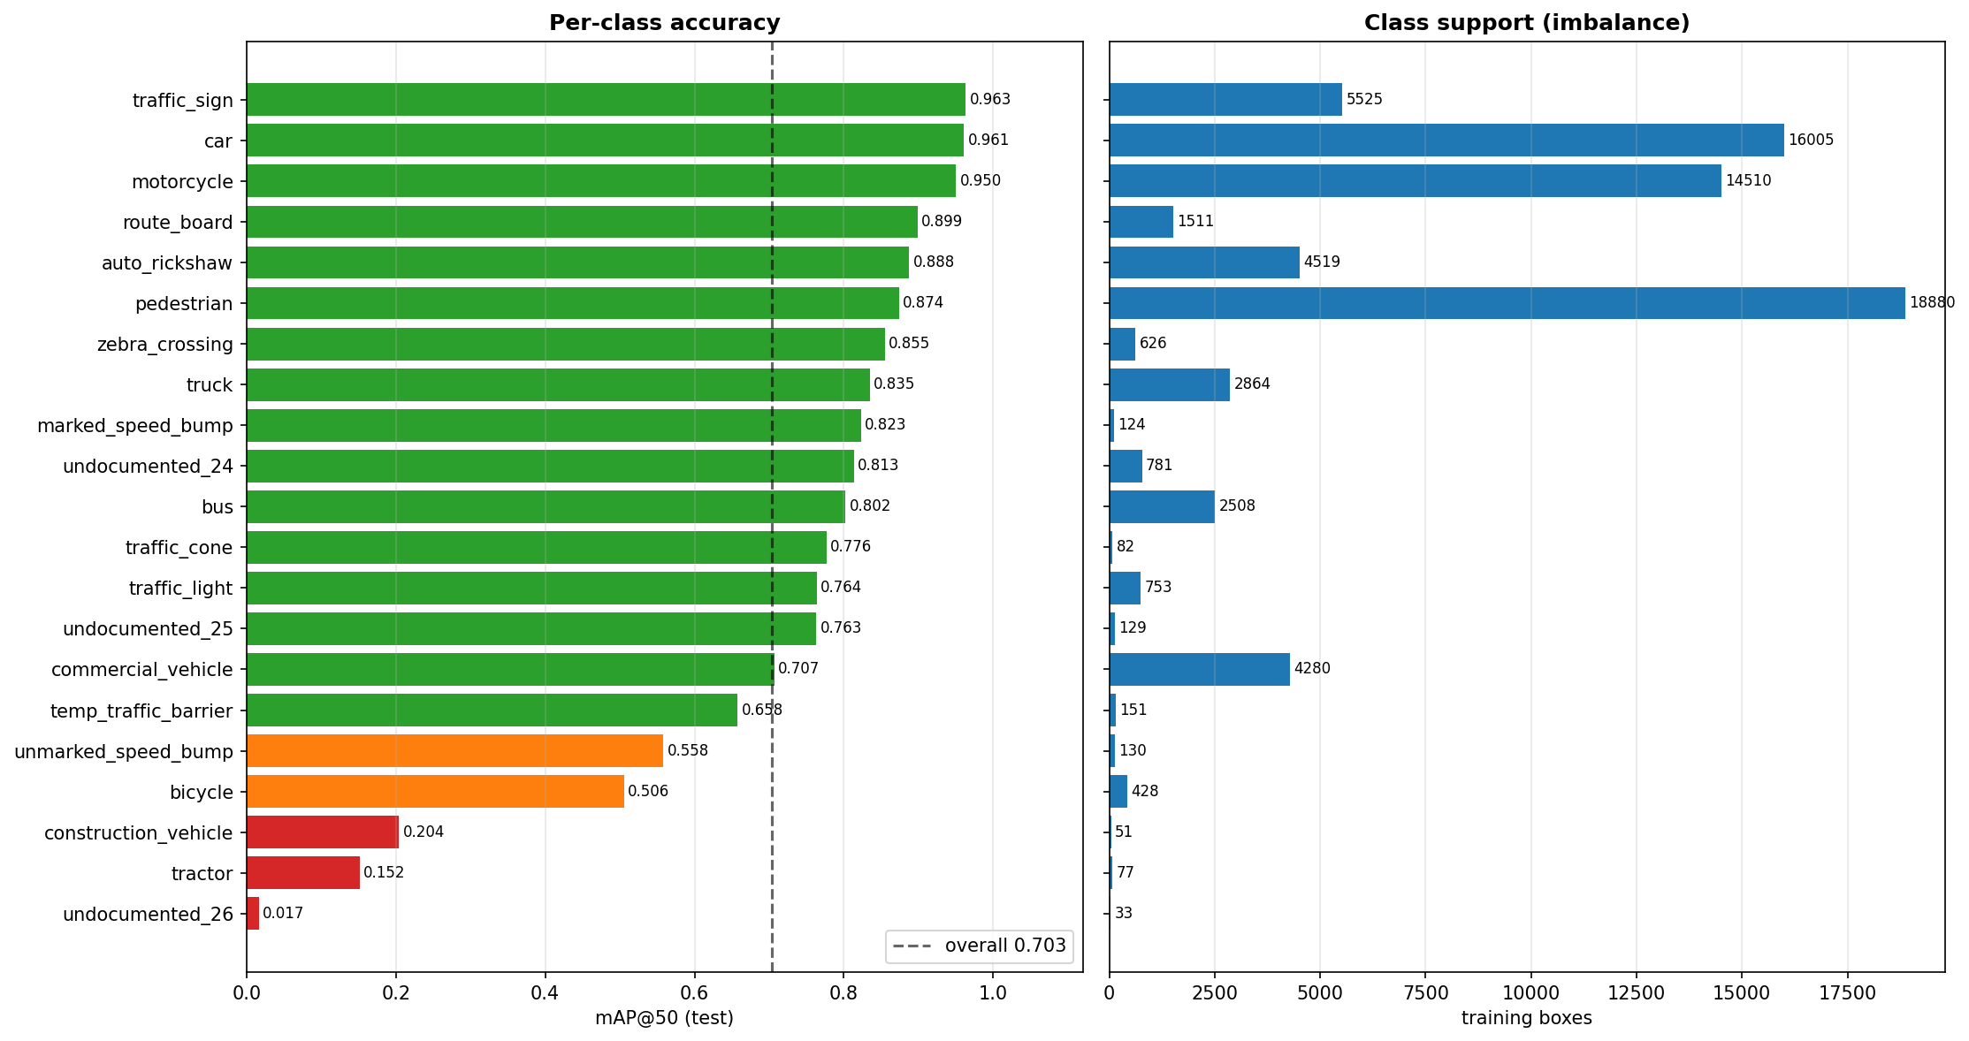
PER-CLASS ACCURACY
Auto-rickshaw 0.888, above the overall mean
A class COCO does not have at all
Speed bump: 0.823 from just 124 training instances
Commercial vehicle: 0.707 from 4,280 instances
Visual distinctiveness matters more than sample count

Slide 12
CHALLENGES
Viewpoint gap: DriveIndia is dashcam, enforcement cameras are elevated
Seen from above, a car roof and a bus roof are both large rectangles
Our test accuracy holds for dashcam, not yet for overhead CCTV
BMD-45 measures the same collapse: 83.8% in-domain, 33.6% cross-domain [4]
Calibration: one direction per camera flagged 8 legally-travelling vehicles
The system now abstains outside any declared lane rather than guessing

Slide 13
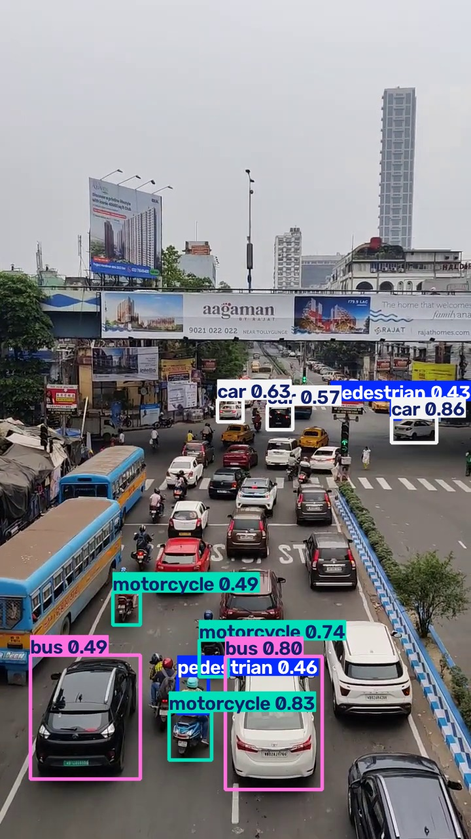
THE DOMAIN GAP, MADE VISIBLE
Cars, motorcycles, auto-rickshaws, pedestrians: correct
Large vehicles seen from above: mislabelled
Trained on dashcam imagery, tested on an elevated view

Slide 14
NOVELTY
Kerala AI cameras: 66.41 lakh violations, Rs 428 cr in challans issued
Only Rs 76.7 cr collected. Detection was never the bottleneck.
Bengaluru: AI helmet fines are revalidated MANUALLY before issue [10]
Detection confidence says "that is a motorcycle"
It says nothing about whether the challan survives a challenge
EDS scores five dimensions: 80+ auto, 50 to 80 review, below 50 drop

Slide 15
ADAPTIVE SIGNAL TIMING
The same detection pass, a second output: enforcement punishes, timing prevents
Congestion measured per junction arm in PCU, not vehicle count - 40 motorcycles are not 40 buses [11]
Webster's method: C = (1.5L + 5) / (1 - Y). Arithmetic an engineer can check by hand [12]
Green follows the queue; a quiet arm still gets its pedestrian minimum every cycle
Past capacity it stops optimising, drains the longest queue, and says which mode it used
ADVISORY ONLY: it recommends a plan and actuates nothing

Slide 16
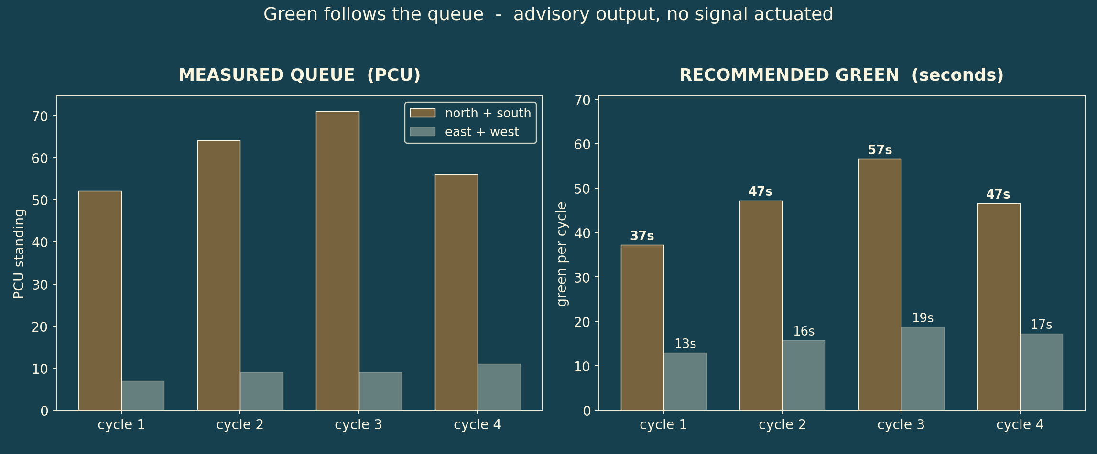
GREEN FOLLOWS THE QUEUE
North-south holds 88% of the standing queue across four cycles
Recommended green moves 37s to 57s as the queue builds
East-west never drops below its 12s pedestrian minimum
Rate-limited to 10s per cycle, so the plan converges instead of lurching

Slide 17
FUTURE ACTIONS
Fine-tune on CCTV-viewpoint imagery to close the domain gap, and complete the rule set with triple riding, red-light jumping, helmet compliance and speed.
1
Build the officer review portal and Motor Vehicles Act challan generation, with plate recognition using multi-frame voting across each vehicle track.
2
Validate the Evidence Defensibility Score against real officer approve and reject decisions, reporting the area under the ROC curve.
3

Slide 18
CONCLUSION
Working pipeline: video in, legally-framed evidence package out
0.703 mAP@50 on held-out test, 0.868 on enforcement classes
Auto-rickshaw 0.888, a class COCO does not have
One perception pass now drives BOTH enforcement and signal timing
Every detection carries a plain-language reason trace
No challan issued, and no signal actuated, without human approval

Slide 19
REFERENCES
[1] Kumar, S. et al. (2025). DriveIndia: An Object Detection Dataset for Diverse Indian Traffic Scenes. arXiv:2507.19912.
[2] Ravish, R., Rangaswamy, S. et al. (2021). Intelligent Traffic Violation Detection. IEEE GCAT. doi:10.1109/GCAT52182.2021.9587520
[3] Ren, Y. (2024). Intelligent Vehicle Violation Detection System Under Human-Computer Interaction and Computer Vision. Int. J. Computational Intelligence Systems 17:40. doi:10.1007/s44196-024-00427-6
[4] Sharma, A. et al. (2026). BMD-45: A Large-Scale CCTV Vehicle Detection Dataset for Urban Traffic in Developing Cities. arXiv:2604.24419.
[5] Rhead, M., Gurney, R., Ramalingam, S. & Cohen, N. (2012). Accuracy of Automatic Number Plate Recognition (ANPR) and Real World UK Number Plate Problems. IEEE 46th Int. Carnahan Conf. doi:10.1109/CCST.2012.6393574
[6] Wilson, C., Willis, C., Hendrikz, J.K., Le Brocque, R. & Bellamy, N. (2010). Speed cameras for the prevention of road traffic injuries and deaths. Cochrane Database of Systematic Reviews, CD004607.
[7] Hoye, A. (2015). Speed cameras, section control, and kangaroo jumps - a meta-analysis. Accident Analysis & Prevention 73:200-208.
[8] Ministry of Road Transport and Highways, Government of India. Road Accidents in India 2023.
[9] Kerala Motor Vehicles Department / KELTRON. Safe Kerala AI Camera Project - reported enforcement figures, first year of operation.
[10] Bengaluru Traffic Police. Intelligent Traffic Management System - reported helmet-detection accuracy and manual revalidation practice.
[11] Indian Roads Congress. IRC:93 - Guidelines on Design and Installation of Road Traffic Signals (Passenger Car Unit equivalency factors).
[12] Webster, F.V. (1958). Traffic Signal Settings. Road Research Technical Paper No. 39, HMSO, London.
[13] Indian Evidence Act 1872, s.65B; Bharatiya Sakshya Adhiniyam 2023, s.63 - admissibility of electronic records.

Slide 20
THANK YOU

